Slide 1
Practical Exercise Overview
Build and install FreeRADIUS
Configure and start FreeRADIUS with LDAP database backend
Test authentication using FreeRADIUS

Slide 2
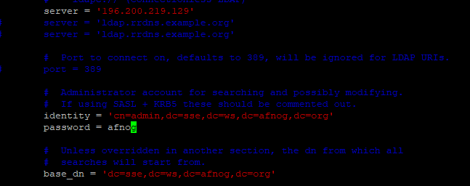
FreeRadius Installation & Configuration
Install FreeRadius with the following commands as below.
apt-get install freeradius freeradius-ldap –y
sudo vi /etc/freeradius/3.0/mods-available/ldap

Slide 3

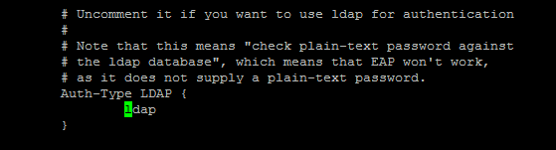
FreeRadius Installation & Configuration Cont..

Slide 4

FreeRadius Installation & Configuration Cont..
vi /etc/freeradius/3.0/users
The above is to enabled LDAP Authentication for users.
Also copy ldap file from mod-available directory to the mod-enabled directory as below.
sudo cp /etc/freeradius/3.0/mods-available/ldap /etc/freeradius/3.0/mods-enabled/

Slide 5
FreeRadius Installation & Configuration Cont..
vi /etc/freeradius/3.0/sites-available/inner-tunnel
sudo systemctl restart freeradius // Restart the FreeRadius Service

Slide 6
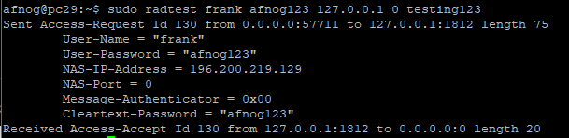
Testing FreeRadius authentication against LDAP
sudo radtest frank afnog123 127.0.0.1 0 testing123
Where Username = frank
Password = afnog123
Radius Secret = testing123
Also Note that we have a successful authentication as shown in diagram above with radius packet in yellow colors

Slide 7

Securing FreeRadius
vi /etc/freeradius/3.0/clients.conf
The Above is to change the Radius Secret from testing123 to afnog
sudo systemctl restart freeradius //N.B: Restart Radius anytime there are changes done to the config

Slide 8
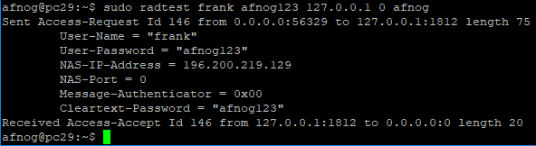
Securing FreeRadius Continue
Run the test as done earlier for the test account and this time round changing the secret to afnog
You should get an Access-Accept packet which shows Radius password has been changed.

